Slide 1


Retail Systems - Bulgaria
IT solutions driving your business
Retail Systems - Bulgaria
Company Presentation
R7/11.11.2010

Slide 2

Retail Systems – Bulgaria
Profile:
At this company we are dedicated to serve the retail business
Our mission is to provide high-end solutions to our customers and partners built around first class software, hardware and system integration services
We strive to provide complete service to the customer – since business case analysis through consultancy, building solution and after-sales support and service
We deliver high quality products through direct partnership with leading global manufacturers
We offer broad product portfolio to fulfill every customer demand
About us
Retail Systems – Bulgaria
IT solutions driving your business

Slide 3








Premium Partners
Barcode scanners
Mobile computers
EAS anti-theft security and loss prevention solutions
Source tagging programmes
POS systems
Self-service and self-checkout systems
High theft solutions
Open display security
Retail and Industrial scales
Wrapping and packaging machines
Retail merchandising solutions
Electronic Shelf Labels
Shelf optimization solutions
Partners
Retail Systems – Bulgaria
IT solutions driving your business

Slide 4

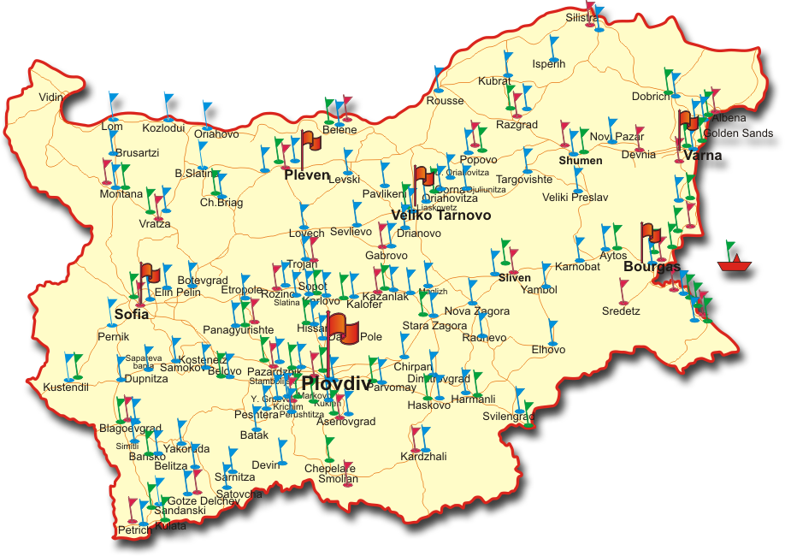
Clients
Since our first installation in early 1995 more than 1500 customers from all around the country prefer our products and services. RETAIL SYSTEMS is one of the main IT & AIDC solutions supplier in Bulgaria today!
We keep
this space
for you!
Clients
Retail Systems – Bulgaria
IT solutions driving your business

Slide 5
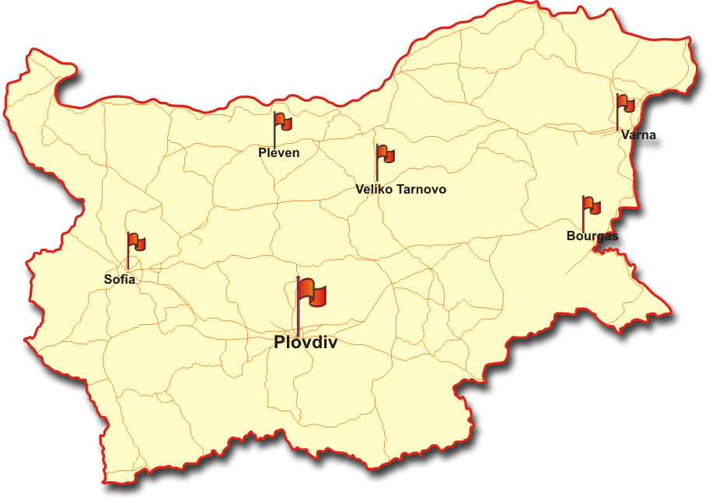
Offices
Our infrastructure of offices in the major cities of the country enable us to be close to our customers and render service at any point it is required.
Head Quarter:
  Plovdiv
Regional Offices:
  Sofia
  Varna
  Bourgas
  Pleven
  Veliko Tarnovo
Did you know ?
  There is a 56%* chance that we have office in your city
  Or, if not, there is a 82%* chance that we are no longer than 50 km away from you
  ^{*)} Percentage calculated on the statistics of population among cities in the country
Offices
Retail Systems – Bulgaria
IT solutions driving your business

Slide 6

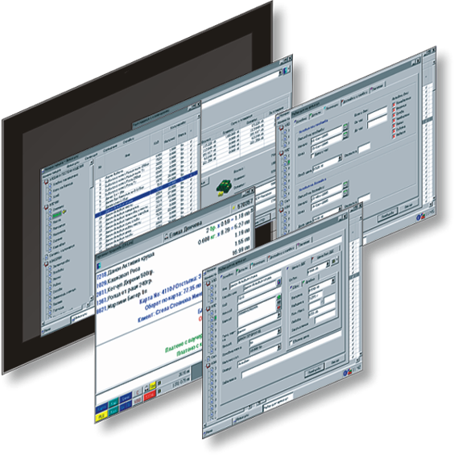
Software solutions
The STORE® system is proven software for retail stores management and automation:
Complete Back-Office automation
Optimized easy-to-use Front-Office/POS
Mobile terminal support for everyday tasks automation
Supply chain management (SCM)
Centralized control of the whole chain
Automated re-ordering
Customer loyalty bonus systems
Traceability and expiration dates control
100% real-time
Off-Line emergency system
Embedded support for broad range of specialized POS hardware
Controlling of operational expenses
Local and light-weight manufacturing automation
Intelligent and intuitive user interface
STORE® software
Retail Systems – Bulgaria
IT solutions driving your business

Slide 7
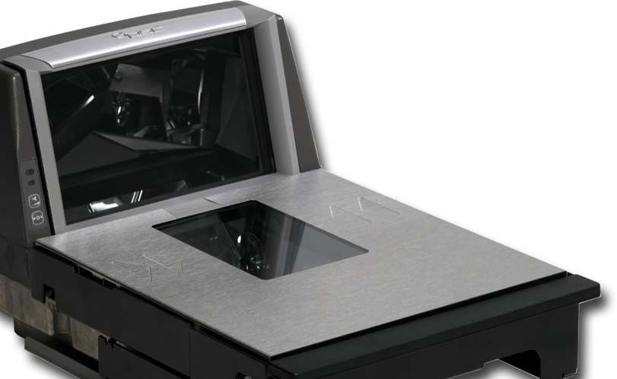
Barcode scanners
High-performance retail POS barcode scanners – Magellan®
  Bi-optic in-counter scanners
  Single-plane in-counter and on-counter scanners
Handheld barcode scanners – QuickScan®, Gryphon®
  Corded
  Cordless – Bluetooth and RF
Industrial rugged scanners – PowerScan®, designed to works in harsh industrial environment
Application/market sectors – retail, warehousing, manufacturing, logistics, postal services, banking, healthcare, public administration and many others
Supported barcodes – all standard 1D and 2D barcodes (depending on the model) including GS1 DataBar and DataMatrix
Datalogic Scanning
Retail Systems – Bulgaria
IT solutions driving your business

Slide 8
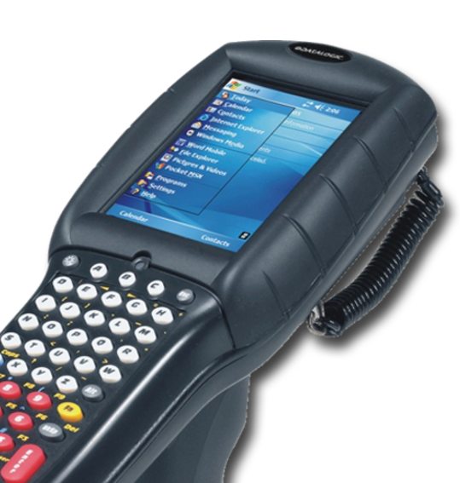
Mobile computers
Broad range of rugged mobile computers with integrated barcode scanner, touch-screen display and rich set of communication options.
Application:
Retail: Mass and General Merchandisers, Warehouse Clubs, Do It Yourself, Specialty, Pharmacy, Grocery and Convenience Stores – Store management, Inventory, Asset tracking, Shelf replenishment, Price management, Order Management, Assisted sales, Mobile POS (e.g. Line busting)
Warehouse Management – Inventory, Asset tracking, Picking, Shipping/receiving, Shelf replenishment, Price management, Put away, Cross docking
Field Force Automation: Sales, Service and Courier – Workforce Management, Parcel Pick-up and delivery, Proof of Delivery, Fleet Management, Access Control, Inventory management, Order management, Order and price look-up, Mobile CRM, Route management
Communications: GSM/GPRS/EDGE, UMTS HSDPA, 802.11b/g, Bluetooth, GPS
OS: Windows CE, Windows Mobile
Datalogic Mobile
Retail Systems – Bulgaria
IT solutions driving your business

Slide 9
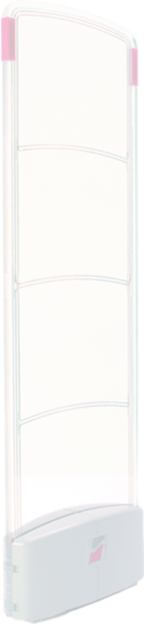

EAS anti-theft security and loss prevention
EAS anti-theft and loss prevention systems. Technologies:
  Radio-Frequency (RF)
  Electromagnetic (EM)
  Dual-technology (RF+EM)
  Dual-technology (RF+RFID)
Source Tagging programmes for protecting goods at the point of manufacture
Rich portfolio of security elements for protecting merchandise against theft:
  General purpose hard tags and soft tags
  Special application tags for apparel, food, bottles, glasses, blister packages, CD/DVD, etc.
  Special protection for high-risk items with keepers, spiders, cable locks, etc.
Complete Shrink Management Solutions
ShowSafe™ loop protection system for expensive merchandise and samples on open display (cell phones, cameras, notebooks, LCD&TV, GPS and other electronics)
Checkpoint
Retail Systems – Bulgaria
IT solutions driving your business

Slide 10
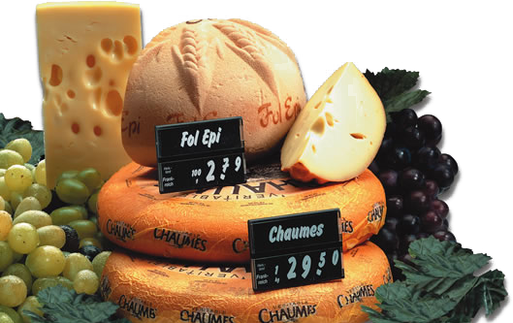
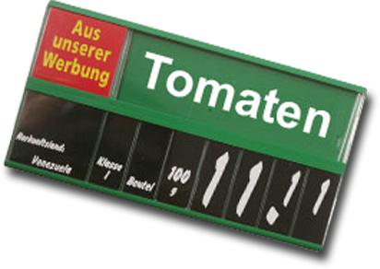
Retail Merchandising
Solutions
Retail Merchandising Solutions help increasing your sales by improving visual communication with your customers, emphasize your promotional messages, achieve pleasant shopping environment and distinctive look to your store.
Store communication:
Fresh goods merchandising
Emotional sales promotion
Shop-in-shop
Exterior communication
Brand image
Customer direction systems
Shelf communications:
Customer direction systems
Shelf optimization systems
Product information systems
Checkout merchandising
Article security
Communication and promotion:
Price-marking
Information
Promotion
Identification / controlling / security
Checkpoint, POS Tuning
Retail Systems – Bulgaria
IT solutions driving your business

Slide 11
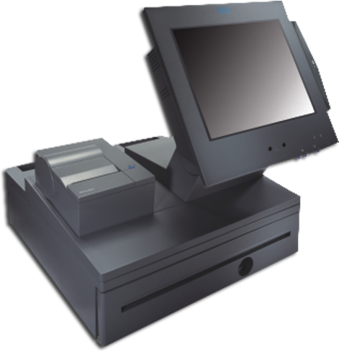
POS hardware
POS hardware with proven reliability:
SurePOS™ POS-systems
Self-service and self-checkout systems
Kiosk terminals
POS Peripherals:
  SurePoint™ touch-screen displays
  SureMark™ POS printers
  POS keyboards
  Cash drawers and tills
IBM
Retail Systems – Bulgaria
IT solutions driving your business

Slide 12
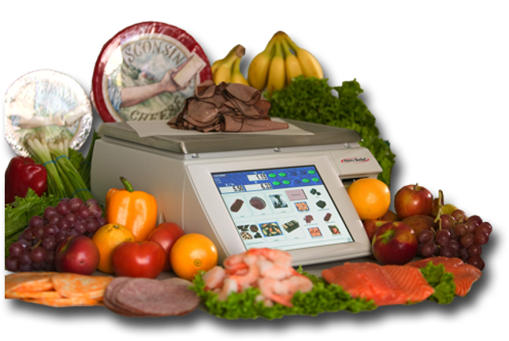
Electronic scales
Electronic scales:
  MP series – Windows PC-based system scales and printers
  XM series – PC-based system scales and printers
  M² series – high-end system scales and printers
  IM series – middle range system scales
  IX series – economic range system scales
  FX series – POS and price-computing scales
Automatic and semi-automatic weigh-wrapping machines – WA/WS series
Applications and features – weighing, counting and labeling, fresh counter operation, receiving, pre-pack, vendor and self-service operation, touch-screen operation, point-of-service multimedia advertising
Avery Berkel
Retail Systems – Bulgaria
IT solutions driving your business

Slide 13
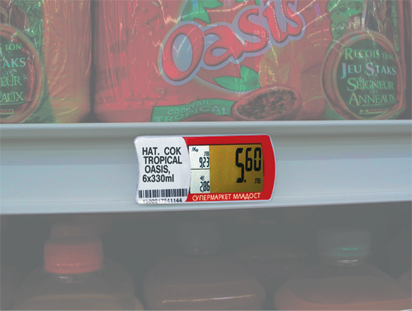
Electronic Shelf Labels
Key system features:
Automated price changes save time, consumables and human work-force
No more problems with incorrect prices on the shelf
Gain additional benefits by more flexible pricing policy
Flexible time-based promotions (e.g. “happy hour”), weak-time discounts, overnight prices
Facilitates inventory control, preparing daily orders and shelf replenishment conforming to the store’s planogram
Localized Bulgarian version is available
Shows prices both in LEVA and EURO currency plus price per 1 kg / l / m / pc
Patented locking mechanism for easy removal and anti-theft protection
Patented communication technology providing reliable transmission
Communication does not interfere with other wireless equipment
Long battery life with option for battery replacement
SES E.S.L.
Retail Systems – Bulgaria
IT solutions driving your business

Slide 14

After-sales support and repair services
We take care that your investment serves you long time trouble-free by providing various support options:
Remote support over the Internet
Local on-site support
Warranty and after-warranty support
Flexible maintenance plans with spare equipment
Maintenance audits
Consultancy
Support
Retail Systems – Bulgaria
IT solutions driving your business

Slide 15
Have a question ?
Just remember – we’ re here to help!
Call us on +359 700 1 08 07 or e-mail to office@retailsys.bg
?
Questions ?
Retail Systems – Bulgaria
IT solutions driving your business

Slide 16

Thank you!
Contacts:
+359 700 1 08 07 www.retailsys.bg
Thank you!
Retail Systems – Bulgaria
IT solutions driving your business

